Slide 1
Weekly Report 2
Digital audio workstation – brandon smith, alice bruce, Clayton sanner

Slide 2
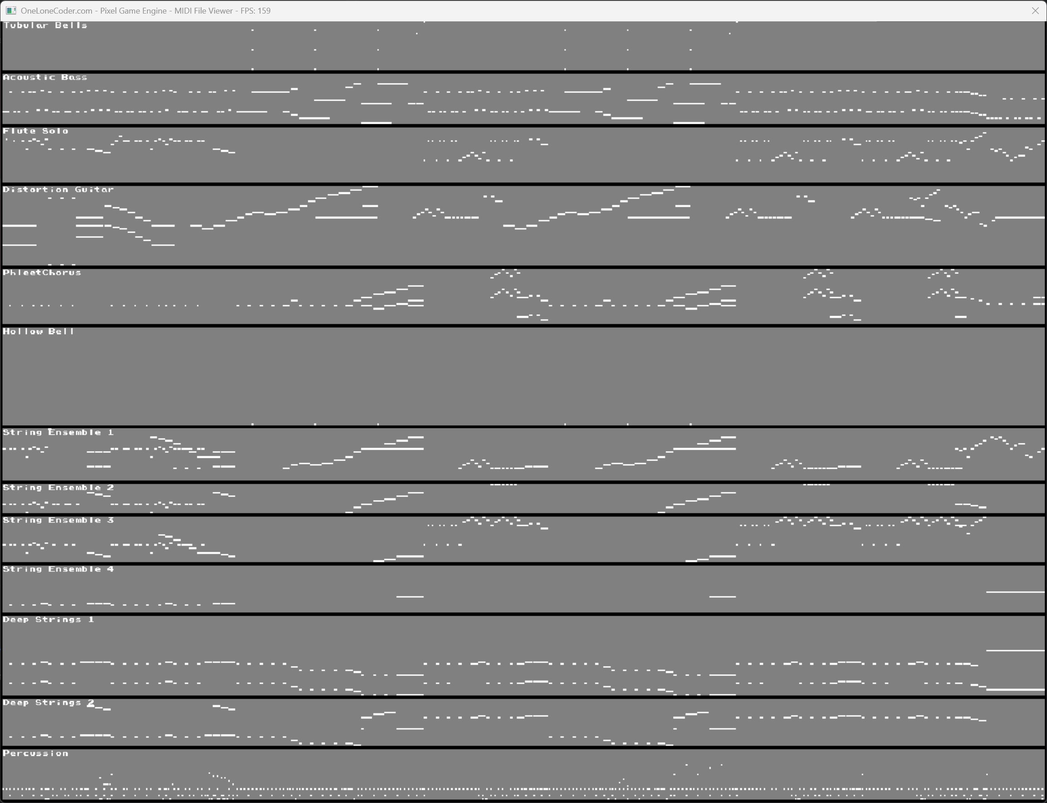
Visual Representation
MIDI file visual
Different instruments

Slide 3

Gui Engine Change
Needed to change from the old engine
Long term would be ineffective for the things we are doing with the project
Replacement is widgets

Slide 4

Issues Faced this week
Fixed the compiler issues by using a different compiler that was easier to use
We replaced the attempt use of VisualStudioCode with Clion
Building the environment for wxWidgets
Saving and importing had to be put off until we have a more interactive program

Slide 5




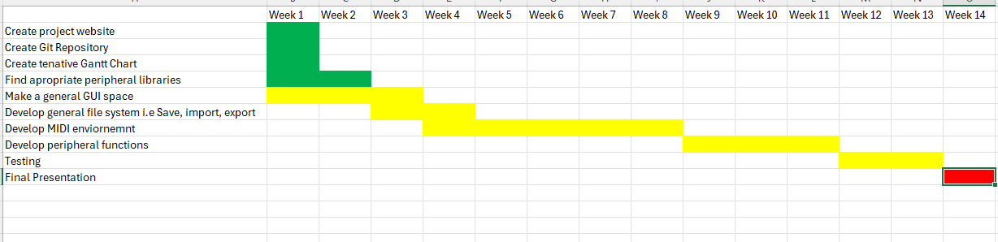

Conclusion

